Slide 1


SYNCHRONICITY
VS. COINCIDENCE
Dr. Lance Storm
Brain and Cognition Centre
School of Psychology
University of Adelaide

Slide 2
SYNCHRONICITY vs. COINCIDENCE
Five Aims
Define Key Terms, including Synchronicity.
Contrast synchronicity with ‘meaningless chance groupings’.
Merge the two concepts, synchronicity and ‘psi’ (shorthand for paranormal effects).
Describe the Chinese system of divination, I Ching, in synchronistic terms.
Discuss the frequency of synchronicity, and the usefulness of the concept.

Slide 3
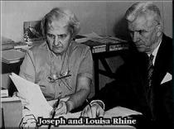
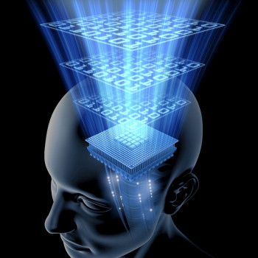
SYNCHRONICITY vs. COINCIDENCE
Defining Parapsychology
Parapsychology is the study of paranormal phenomena (‘paranormal’ = not explained by science). The first formal study of parapsychological processes was by J. B. Rhine (1895-1980) at Duke University, USA, in the 1930s.
Paranormal process and psychic ability are collectively referred to as ‘psi’ (ψ);
Psi includes extra-sensory perception (ESP) and psychokinesis (PK);
ESP includes telepathy (mind-to-mind communication), clairvoyance (distant seeing), and precognition (future-telling); and …,
Parapsychology is also the study of life after death.
Louisa and J. B. Rhine
Notes:
3

Slide 4
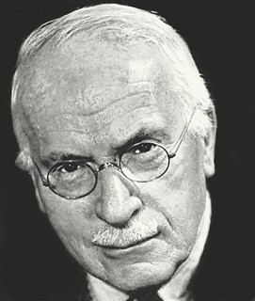
SYNCHRONICITY vs. COINCIDENCE
Defining Jung’s Concept of Synchronicity
Jung claims ESP and PK are synchronicity, which . . .
is a psycho-physical phenomenon, a coincidence of two events; one is subjective (psychic/psychological), and the other is objective (physical); these events are not time-dependent;
is experienced when a certain content in the psyche, and a physical event (or events) of “equivalence” (i.e., they match; they’re similar) are made conscious;
does not seem to result from chance even though it generally appears as chance ⎯ Jung (1875-1961) didn’t say “chance”; he said chance-like.
C. G. Jung (1875-1961)

Slide 5
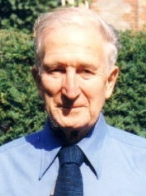

SYNCHRONICITY vs. COINCIDENCE
Defining Jung’s Concept of Synchronicity
Two more things ⎯ synchronicity is . . .
. . . “a coincidence in time of two or more causally unrelated events which have the same or a similar meaning” (Jung, 1960, para. 849);
So . . . synchronicity is (i) not time-dependent, and
(ii) it is meaningful ⎯ the synchronistic components
form the basis of the meaningfulness, which is the
only connecting principle between the events
(i.e., there is no causal connection).
Some philosophers object . . .
IF ANY KIND OF COINCIDENCE
WASN’T MEANINGFUL, IT WOULD
GO UNNOTICED
. . . meaningfulness???

Slide 6
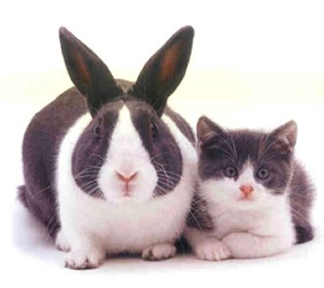
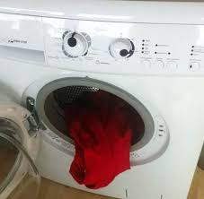
SYNCHRONICITY vs. COINCIDENCE
Meaningfulness
Questions:
As Antony Flew suggests, aren’t all coincidences meaningful?
Can we distinguish between meaningful coincidences and
meaningless coincidences (‘meaningless chance groupings’)?
Answer:
Meaningful coincidence (i.e., synchronicity) does more. It . . .
(i) compensates unconscious one-sidedness (examples later);
(ii) expresses a specific archetypal meaning as an expression
of the ‘self’ in one’s individuation (development of the individual
personality). (More on archetypes shortly.)
Meaningfulness emerges as part of that process.
Do all coincidences do that?

Slide 7



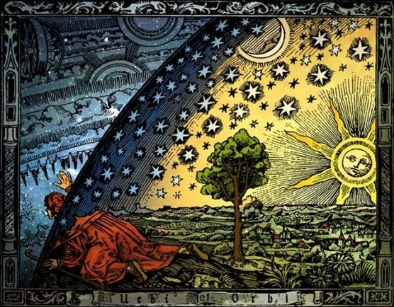
SYNCHRONICITY vs. COINCIDENCE
Meaningfulness
Surely not . . .
. . . but how do we determine meaningfulness?
Meaning-making draws on the functions of sensation, thinking, feeling, and intuition so a conclusion can be reached about the synchronistic event (we do that!);
Ultimately you get your meaningfulness from synchronicity if there’s a transformation of personality;
Jung saw this transformation as the embodiment of the individuation process.
Lot’s of terms.
Perhaps it’s time for an example . . .

Slide 8

SYNCHRONICITY?
HUH ! ! !
EXAMPLE PLEASE ! ! !
Notes:
8

Slide 9



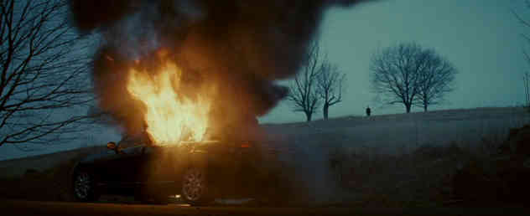
SYNCHRONICITY vs. COINCIDENCE
Hollywood does a good job of capturing the essence of synchronicity:
In the film Michael Clayton (2007), Clayton is a ‘Fix-It’ man for a law firm. He has ‘enemies’; his life is a mess ⎯ can’t realize his full potential. His son Henry asks him to read “Realm & Conquest”, a manual for a computer game.
The manual shows horses under a tree in a field.
Later on, while driving, Clayton sees horses in a field, and leaves his car to go to them.
Clayton’s car explodes, triggered by his enemies. He starts a new life where he makes his own choices.

Slide 10

SYNCHRONICITY vs. COINCIDENCE
Meaningfulness
So, the meaningfulness is obvious to Clayton ⎯ but let’s break this down . . .
Jung (1960) claims: “Synchronicity postulates a meaning which is a priori
[pre-existent] in relation to human consciousness” (para. 942) ⎯ it apparently
exists outside us.
Again, some philosophers object . . .
Questions: As Stephen Braude implies, isn’t meaning subjective? Aren’t
Clayton’s decisions subjective? Do we all agree with him? Why?
Answer: Jung recognises subjectivity, but his focus is mainly on
archetypal meaning. The meaningfulness that comes with archetypes
is more universal (human-wide). That is, if the meaning is archetypal,
it’s generally meaningful.
NATURE . . . DOES NOT
DICTATE HOW WE INDIVIDUATE
EVENTS
Archetypes; what are they?

Slide 11
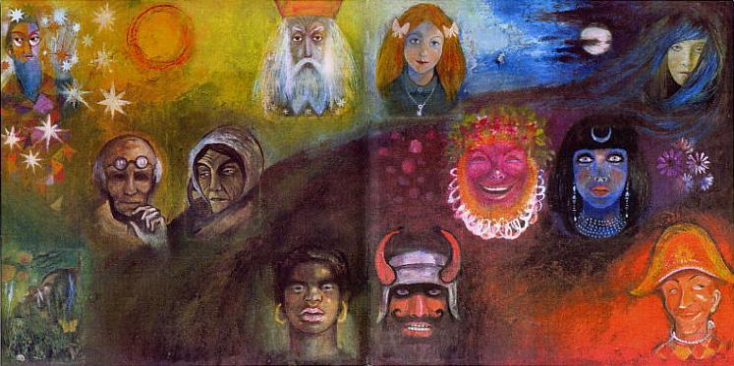
SYNCHRONICITY vs. COINCIDENCE
Archetypes
Jung says archetypes underscore synchronicity. Archetypes are structural components of the collective unconscious (deep in the mind) that influence how we think and act. They are represented in literature (myths, folk-lore, fairy-tales, sacred texts), dreams, and fantasies. E.g., Hero, Wise Old Man, Child.
Notes:
11

Slide 12





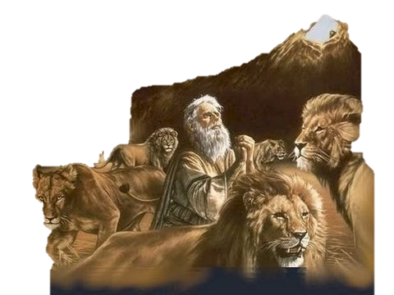

SYNCHRONICITY vs. COINCIDENCE
Archetypes
Other examples: geometrical forms . . .
. . . flowers, trees, . . .
. . . persona (mask) . . .
. . . animals, etc., etc., etc.

Slide 13
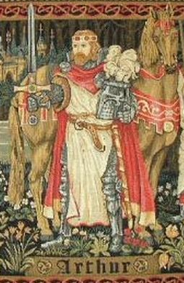

SYNCHRONICITY vs. COINCIDENCE
Archetypes
Important points about archetypes:
An archetypal meaning is an age-old meaning.
A specific archetype carries the same general meaning across cultures ⎯ human experience (how we perceive) and human behaviour (how we act) are thereby ‘standardized’.
So, although, meaningfulness is largely subjective (requires interpretation), archetypal meaning (because it’s in the culture, even carries across cultures) is more objective.
That means we can get agreement on what the psychophysical events may mean. Applies to transformation of personality too.
Notes:
13

Slide 14
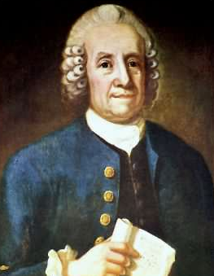
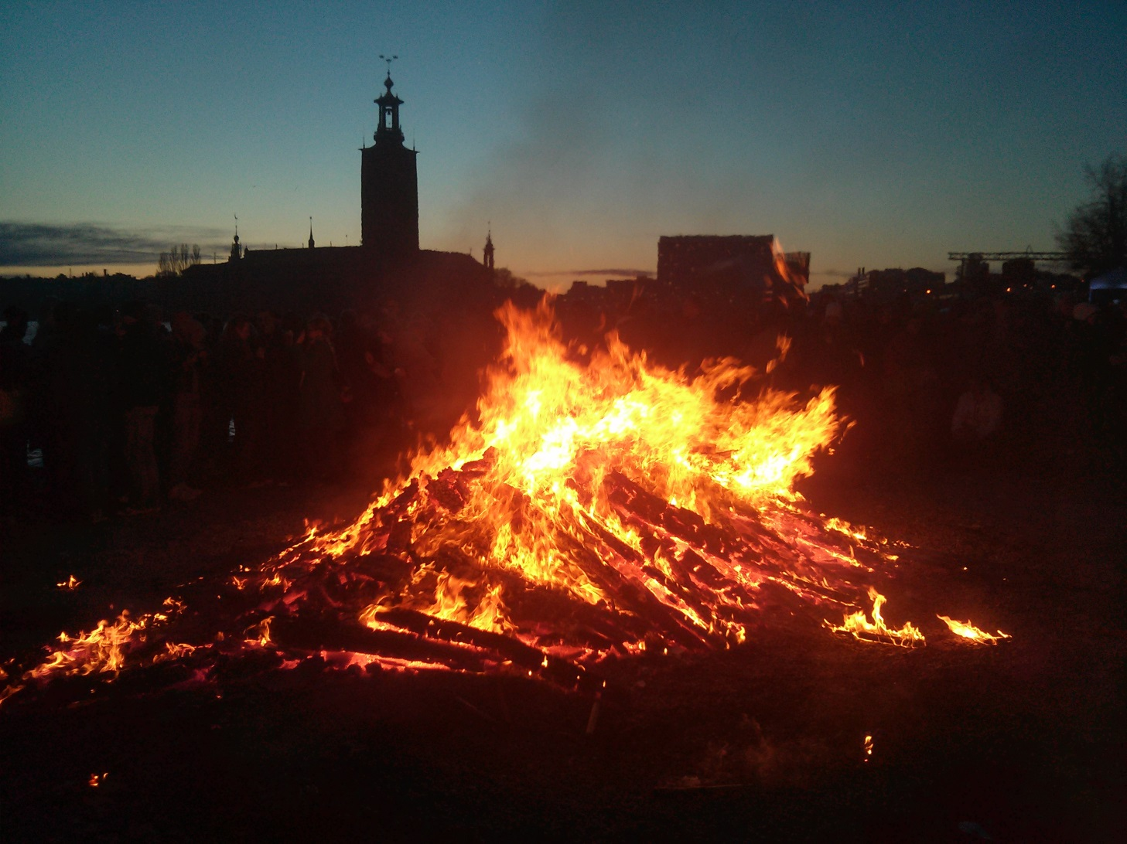
SYNCHRONICITY vs. COINCIDENCE
Synchronicity contrasted with meaningless chance groupings
Example of Synchronicity:
In 1759, at a party in Gothenburg, Swedish religious leader,
scientist, philosopher, and mystic, Emanuel Swedenborg
(1688-1772), in an agitated state, had a vision of houses
on fire nearly 500 km away in Stockholm. Jung writes:
“When . . . the vision arose in Swedenborg’s mind of a fire in
Stockholm, there was a real fire raging there at the same time,
without there being any demonstrable or even thinkable
connection between the two.”
Swedenborg gave dinner guests, and later the Gothenburg
city authorities, an account of this fire, including such details as the
time of the fire and when it was put out. He was even relieved that the fire
stopped three doors from his own house.
Notes:
14

Slide 15


SYNCHRONICITY vs. COINCIDENCE
Synchronicity contrasted with meaningless chance groupings
It took two to three days for news from Stockholm to reach Gothenburg by courier. The fire had consumed 300 houses.
Jung makes a point of this “fire burning in him [Swedenborg] too” as being the prime ingredient of the synchronistic event. This was born out in Swedenborg’s biography, whereby his psychological state gives indication of the likelihood of an
“inner fire” (fear, anxiety). NB: archetype of fire in myth.
Swedenborg’s ‘inner’ (or spiritual) fire is of particular
meaningful (i.e., psychological) significance, and is not simply a typical psi phenomenon (clairvoyance), although Jung believed that ESP and PK share the same phenomenology as synchronicity.
The key to synchronicity is the inner/outer link.
Notes:
15

Slide 16
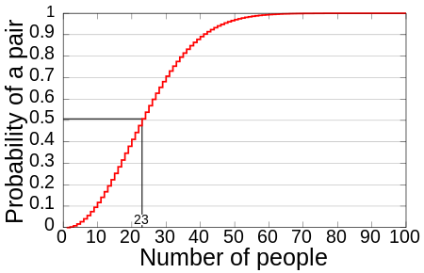
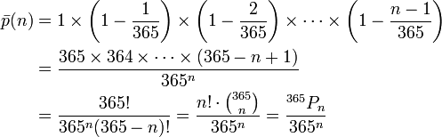
SYNCHRONICITY vs. COINCIDENCE
Synchronicity contrasted with meaningless chance groupings
Example of a Coincidence (but not Synchronicity):
The Birthday Paradox ⎯ two strangers meet up in a roomful of people and discover they have the same birthday? Synchronicity?
The probability of two people having the same birthday is very high (99%) in a room of only 57 people! The graph below shows the approximate probability of at least two people sharing a birthday amongst a certain number of people.
Here’s how to work it out:
Notes:
16

Slide 17

SYNCHRONICITY vs. COINCIDENCE
Synchronicity contrasted with meaningless chance groupings
Two people meeting up and having the same birthday in a roomful of people is not synchronicity because “there is no simultaneous, inner-meaningful, subjective event” (Wilmer, 1987).
We only have a meaningless chance grouping ⎯ a coincidence in the conventional sense. Piling up more and more shared facts (e.g., they are the same gender, or they received the same birthday present) won’t necessarily turn it into synchronicity.
In order to satisfy the conditions of synchronicity, an inner psychic experience would be required from at least one of the two people directly relating to the events at hand (say, a precognition of the event), or any other kind of paranormal, or causally inexplicable component.
Furthermore, some kind of archetypal content would help make the coincidence meaningful.
Notes:
17

Slide 18
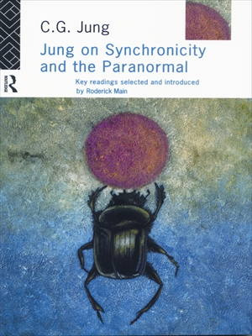
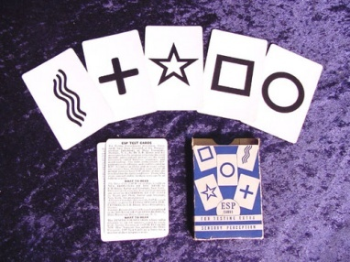

SYNCHRONICITY vs. COINCIDENCE
Synchronicity and Psi
As I said, for Jung synchronicity = psi (ESP & PK).
How similar are they?
The physical event may occur at the same time as an experience in the psyche, even at distances outside the range of the normal sensory modalities (cf. telepathy and clairvoyance);
Synchronicity is not time-dependent where cause must precede effect (cf. precognition);
Synchronicity is not dependent upon spatial determinants (cf. psychokinesis);
So, synchronicity is like ESP and PK. But there are
other similarities . . .
Notes:
18

Slide 19
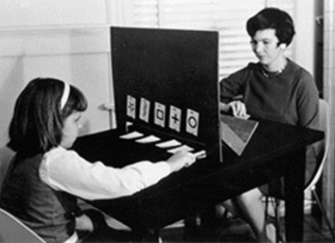
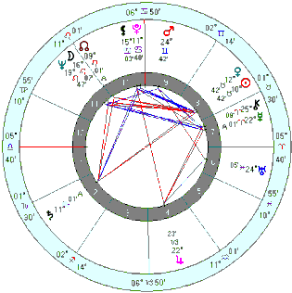

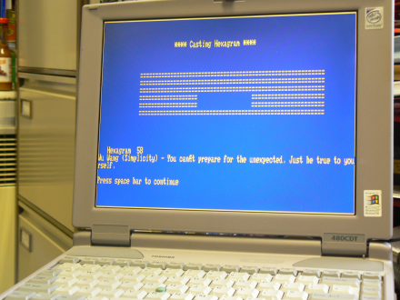
SYNCHRONICITY vs. COINCIDENCE
Synchronicity and Psi
Like synchronicity, psi can appear as a chance-like effect
(both are determined approximately).
Like synchronicity, psi can be meaningful: “an affective [emotional]
expectation is present in one form or another [in an ESP
experiment] even though it may be denied” (Jung, 1960, para.848).
Like psi, synchronicity can be the subject of experimentation.
It is not sporadic, and can be repeatable. Lots of examples:
Jung’s (1960) astrology experiment;
Braud’s (1983) meaningful coincidences study;
Storm’s (2008, 2009) six I Ching studies;
Roe, Martin, and Drennan’s (2010) I Ching study;
Houran and Lange’s (2012) I Ching study;
plus a new I Ching study described shortly (Storm, 2012).
What is the I Ching?

Slide 20
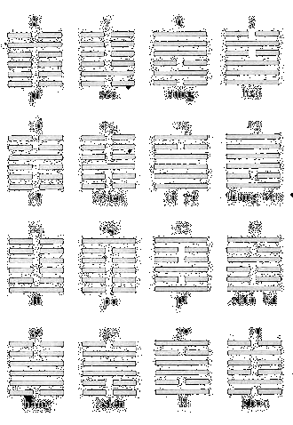
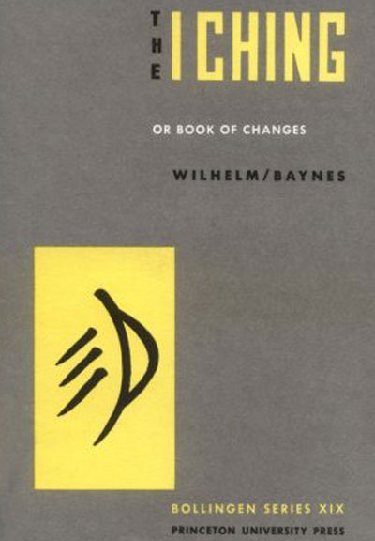
SYNCHRONICITY vs. COINCIDENCE
The I Ching
The I Ching is an ancient Chinese system of divination.
Here’s how it works:
You ask a question, and then throw three coins six times to generate a hexagram.
There’s 64 hexagram, and each has its own reading; meant to be an answer to a pressing question.
Jung: “the matter of interest [your answer; your reading] seems to be the configuration formed by chance events in the moment of observation.”
Seems to be chance? Maybe not.
Notes:
20

Slide 21
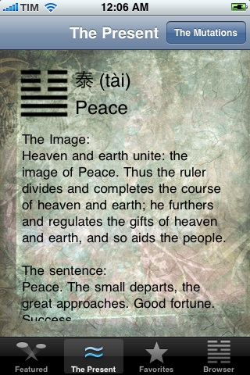
SYNCHRONICITY vs. COINCIDENCE
The I Ching
Jung’s view (from the Foreword to Wilhelm’s The I Ching):
“the hexagram was understood to be an indicator of the essential situation prevailing in the moment of its origin.”
“. . . the sixty-four hexagrams of the I Ching are the instrument by which the meaning of sixty-four different yet typical situations can be determined.”
“The ancient Chinese mind contemplates the cosmos in a way comparable to that of the modern physicist, who cannot deny that his model of the world is a decidedly psychophysical structure.”
“Psychophysical”? So, Jung is saying the I Ching process might involve synchronicity.
Notes:
21

Slide 22
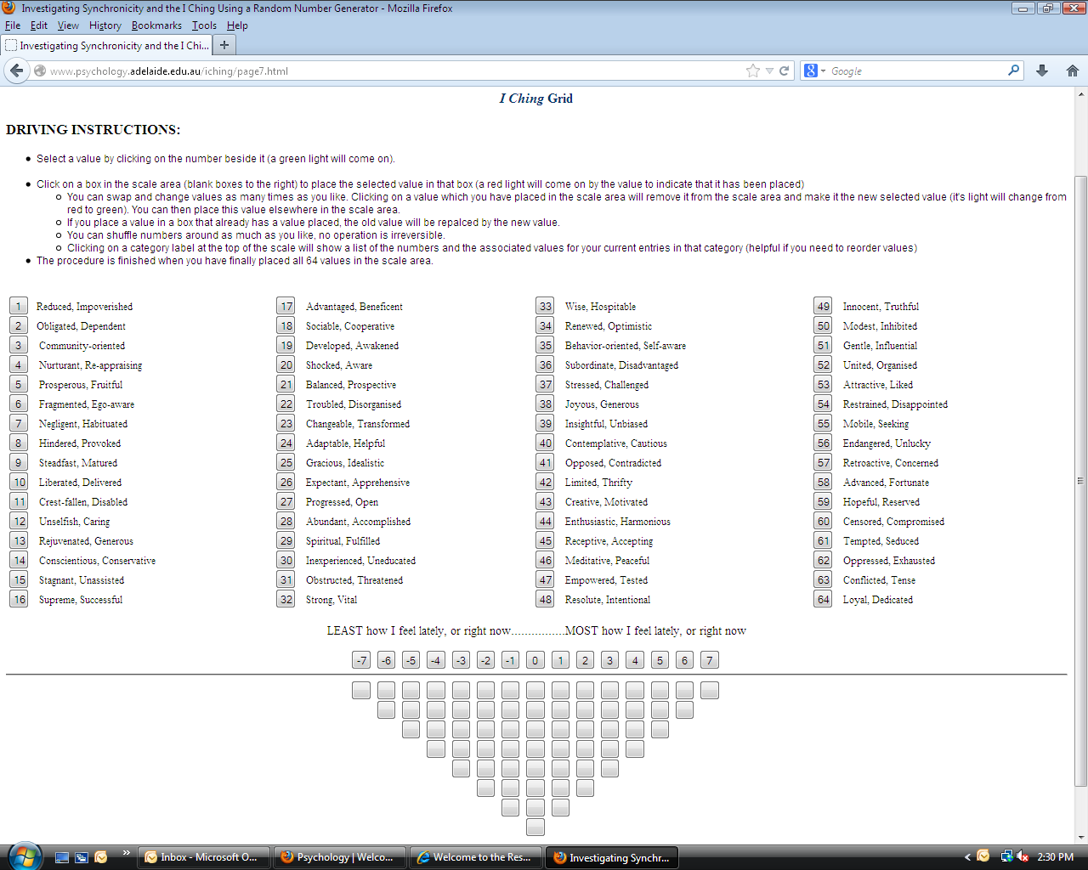
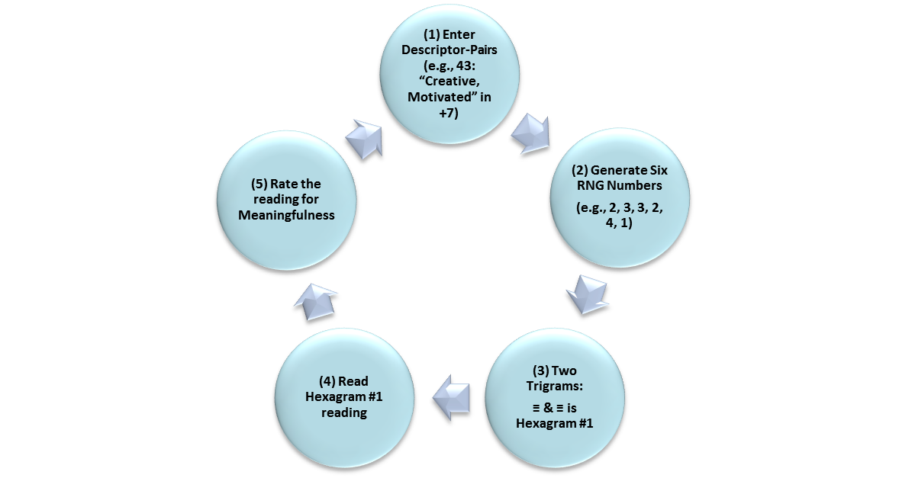


1.
Synchronicity (Psi), Paranormal Belief & Meaningfulness
(1) Believers’ Q-Sort & RNG scores (.30; 3.45) > non-believers’ scores (.07; .64).
Time for an I Ching Experiment
AIM: Create Synchronicity in the Lab using a Q-Sort Grid to map the ‘psyche’ (‘inner’) and correlate it with Hexagram generation (‘outer’).
RESEARCH QUESTION: What parts are played by paranormal belief and meaningfulness in the I Ching?
(2) Meaningfulness was higher in believers (77.30) than non-believers (57.54)
(3) Meaningfulness correlated with DIRECT hitting (.15) & BINARY hitting (.21)
Synchronicity?
1
13
32
26
21
49
22
14
23
6
24
33
53
58
43
2.
12
2
27
38
3
42
45
15
63
25
41
52
17
11
20
28
60
19
5
36
62
34
44
55
61
10
4
30
8
46
35
54
56
29
9
59
7
50
18
39
47
37
31
16
57
48
64
51
40
5.
Rate the Reading for
MEANINGFULNESS
Even Numbers =
Odd Numbers =
4.
Read the Reading:
Hexagram #1: The air is ripe with imagination, inspiration and energy. . . . This is a good time to exercise leadership, because you can be strong now . . .”
3.

Slide 23
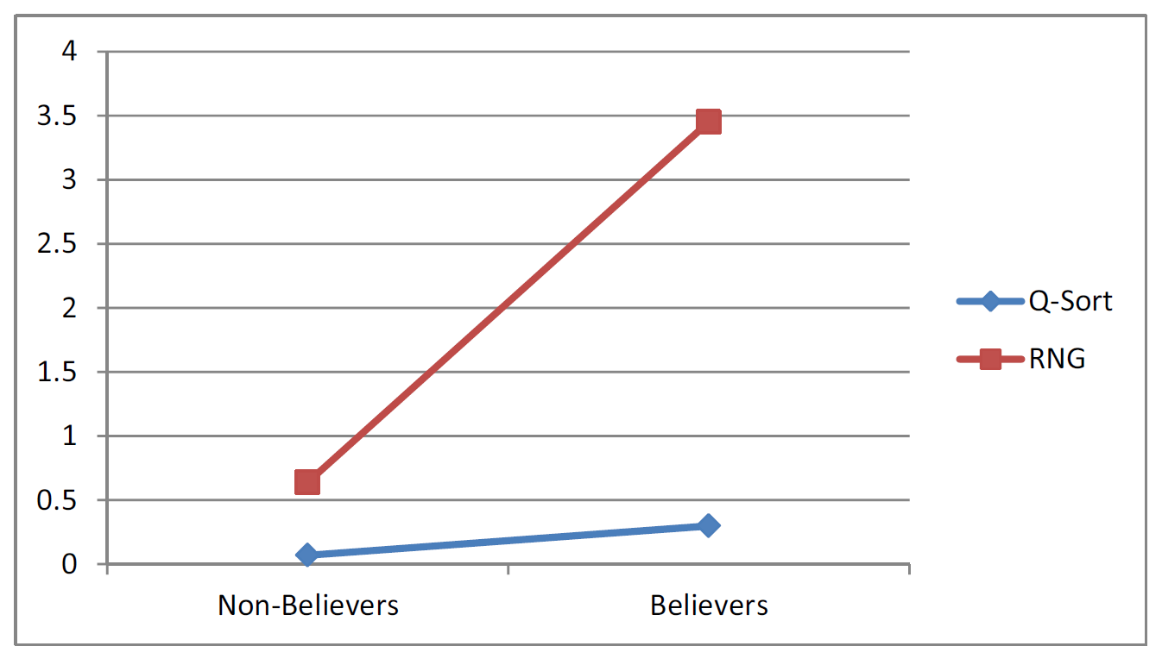
SYNCHRONICITY vs. COINCIDENCE
An I Ching Experiment
Let’s break it down . . .
Statistical evidence of two psi effects, belief effects, and meaningfulness effects.
All these effects are best observed when you look at believers and non-believers separately.
Psi effects (Q-Sort and RNG scores) can’t be explained normally (no casual explanation).
Highest Q-Sort scores (+6, +7) → highest meaningfulness.
A meaningfulness effect goes some way towards proving the equation, psi + meaningfulness = synchronicity.
NB: The participant rates the meaningfulness; you decide!
Notes:
23

Slide 24

SYNCHRONICITY vs. COINCIDENCE
The Importance of Synchronicity . . .
. . . in Parapsychology:
If psi = synchronicity, then parapsychologists have been inadvertently testing synchronicity anyway, although the approaches are different:
On the one hand, psi is studied in the context of “consciousness and the mind-body problem” and freewill “in certain contexts” (Greatrex, 1999, pp. 5-6). What can be influenced? Limits?
On the other hand, synchronicity leans towards issues such as non-intentionality, meaning, and holism (i.e., the whole system). Who is being influenced? Why?

Slide 25

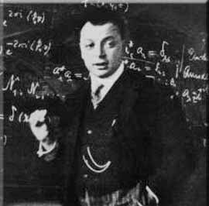
SYNCHRONICITY vs. COINCIDENCE
The Importance of Synchronicity . . .
. . . in Therapy:
When synchronicity occurs between two people in a clinical setting, then the relationship between therapist and client may change ⎯ progress (e.g., Scarab Beetle case).
. . . in Physics:
Wolfgang Pauli (1900-1958) thought synchronicity was relevant to the discipline of physics (Pauli, 1955).
He argued that there is an underlying unity of mind and matter, subjective and objective realities.
Quantum mechanics reveals a subjective element in nature ⎯ the outcome of quantum processes (double-slit) depends upon the way it is perceived by the observer.

Slide 26
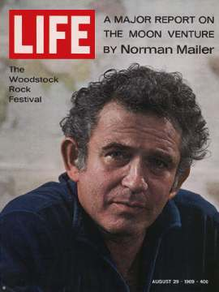
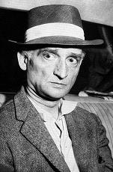
SYNCHRONICITY vs. COINCIDENCE
The Importance of Synchronicity . . .
. . . in Literature:
Author Norman Mailer (1923-2007) was working on his novel Barbary Coast.
There was no Russian spy in it. As he worked on it, a Russian spy became a minor character.
As the worked progressed, the spy became a dominant character.
After Mailer finished the novel, Immigration Services arrested Russian spy Colonel Rudolph Abel, top Russian spy in the US at the time.
Surprisingly, Abel lived in the same building as Mailer, one floor below!

Slide 27


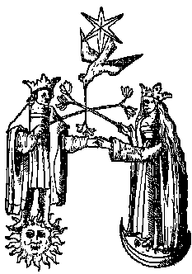
SYNCHRONICITY vs. COINCIDENCE
Conclusions
Synchronicity involves psi and meaningfulness.
Synchronicity is not necessarily chance-like: Single case? Can’t tell; Multiple trials? The experimenter looks for statistical significance ⎯ outcomes suggest synchronicity.
Robert Aziz says “a synchronistic event remains a synchronistic event whether or not its meaningfulness is recognized” (1990, p. 76). See next point . . .
In other words, synchronicity is probably going on around us all the time (Michael Clayton’s ‘close shave’). Pays to be observant. Following from that point . . .
The ‘individuation’ element of synchronicity only comes from conscious awareness. As the psychodynamic theorists tell us: “Nothing is solved in the unconscious.”

Slide 28
The End
Dr. Lance Storm
Brain and Cognition Centre
School of Psychology
University of Adelaide

